Slide 1


CMR TECHNICAL CAMPUS UGC (Autonomous) Kandlakoya, Medchal Road, Hyd-501 401 Department of Computer Science and Engineering
Mini Project Review
CROWD COUNTING METHOD BASED ON CNN
BATCH NO-15
Project Guide:
Ms Raheem Unnisa
Assistant Professor, CSE Department
Project Coordinator:
Prof K. Narasimha Rao
Associate Professor, CSE Department
Presented by:
207R1A0576 : Edula Saketha
207R1A0578 : Gampa Bhavitha
207R1A0566 : Boddu Bharath Kumar

Slide 2
ABSTRACT
Crowd counting is an important research topic in the field of computer vision. The multi-column convolution neural network (MCNN) has been used in this field and achieved competitive performance.
However, when the crowd distribution is uneven, the accuracy of crowd counting based on the MCNN still needs to be improved. In order to adapt to uneven crowd distributions, crowd global density feature is taken into account.
The global density features are extracted and added to the MCNN through the cascaded learning method. Because some detailed features during the down-sampling process will be lost in the MCNN and it will affect the accuracy of the density map, an improved MCNN structure is proposed.

Slide 3
EXISTING SYSTEM
The existing system of crowd counting based on Convolutional Neural Networks (CNN) typically involves two main components: a detection model and a counting model.
The detection model uses CNNs to detect people in the image or video frames. Once people are detected, the counting model uses CNNs to estimate the number of people present.
One popular architecture for the counting model is the crowd counting CNN (CCC). This architecture consists of a series of convolutional and pooling layers that process the image or video frame and produce a density map.
The density map assigns a value to each pixel, indicating the density of people in that area. The density map can be used to estimate the total number of people in the image by summing the values of all the pixels.
The MCNN uses multiple columns of CNNs with different filter sizes to capture features at different scales.

Slide 4
Disadvantages of Existing System
Limited accuracy.
Data dependency.
Difficulty in handling dynamic scenes.
Limited generalization.
Limited interpretability.

Slide 5
PROPOSED SYSTEM
With the rapid development of deep learning and big data, crowd counting methods based on deep learning are proposed gradually.
It is proposed a cross-scene crowd counting model. It was trained alternately through two learning objectives, density map and global number. However, it is not suitable for the change in the scale of crowd.
It is proposed to use the MCNN with three branch networks for crowd counting. Different receptive fields were used in each branch network, and this improved MCNN could adapt to the change in the scale of the crowd.
A convolutional neural network with global density feature by using multi-task network cascades (MNCs) is proposed. In order to generate a more comprehensive density map, the max-ave pooling layers are used to keep more features of the image.
Meantime, the deconvolutional layers are added to the convolutional neural network in order to restore the lost details in down-sampling process. It will help to improve the accuracy of density map and further improve the accuracy of crowd counting.

Slide 6
Advantages of Proposed System
1. Improved accuracy
2. Reduced data dependency.
3. Ability to handle dynamic scenes.
4. Improved generalization.
5. Improved interpretability.
6. Faster processing.

Slide 7
HARDWARE REQUIREMENTS
System : i3 or above.
Ram : 4 GB.
Hard Disk : 40 GB.
SOFTWARE REQUIREMENTS
Operating system : Windows8 or Above.
Coding Language : python.

Slide 8
Novelty Of Project
The novelty of the crowd counting using CNN project is the use of deep learning techniques to accurately estimate the number of people in an image or video sequence. This approach is particularly useful in crowded scenes where traditional counting methods may fail.
One of the key advantages of this approach is that CNN-based models can handle complex and crowded scenes with a high degree of accuracy. This makes them highly applicable in real-world scenarios, where accurate crowd counting is essential for making informed decisions.
Moreover, the use of CNNs for crowd counting is still an active area of research, with ongoing developments in model architectures, training techniques, and data augmentation strategies. This ensures that the field remains dynamic and innovative, with the potential to make significant advancements in the years to come.

Slide 9
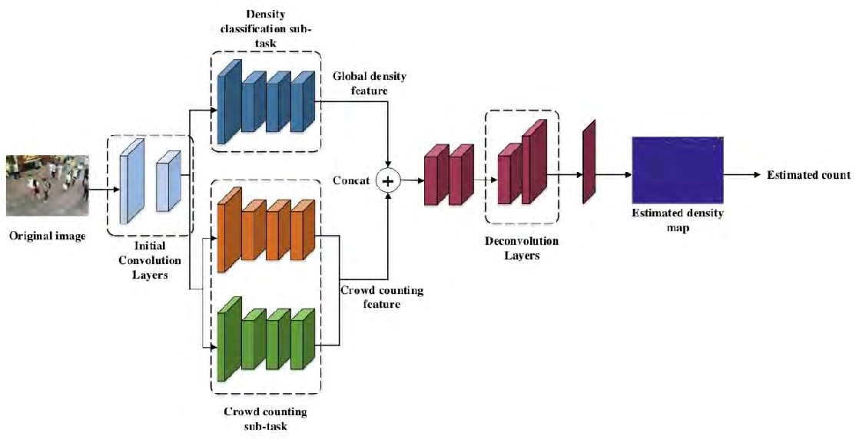
architecture

Slide 10
Modules
Add Product Details
Train Model
Add/Remove Product from Basket

Slide 11
Add Product details To built project we used some sample products image to train product identification models Train Model In this Module screen train model generated with 100% accuracy and now show product to web cam. Add/Remove Product from Basket To allow application to identify product image and then show in text area and if we again show same product then application will remove from text area

Slide 12
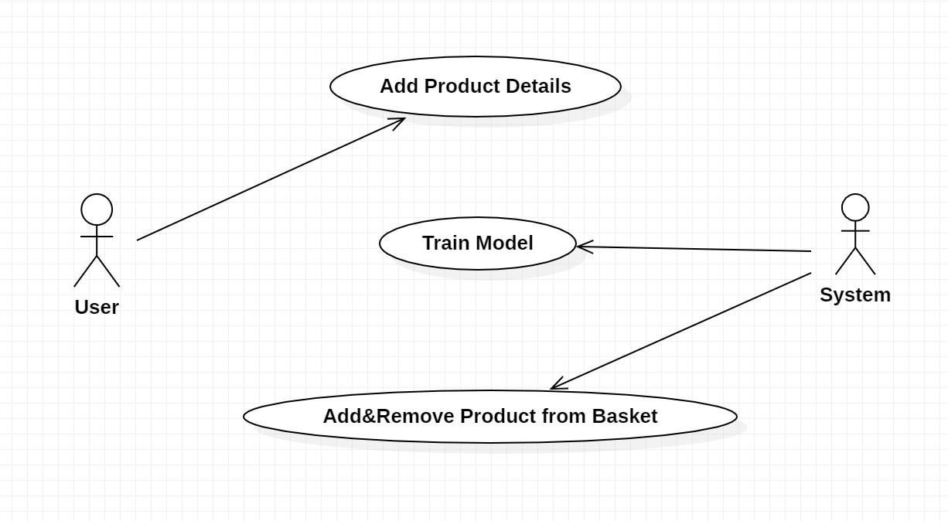
Use case diagram

Slide 13
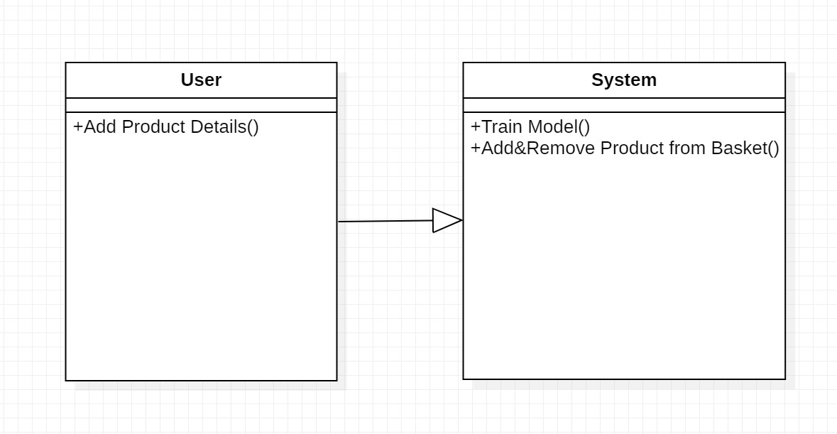
class diagram

Slide 14
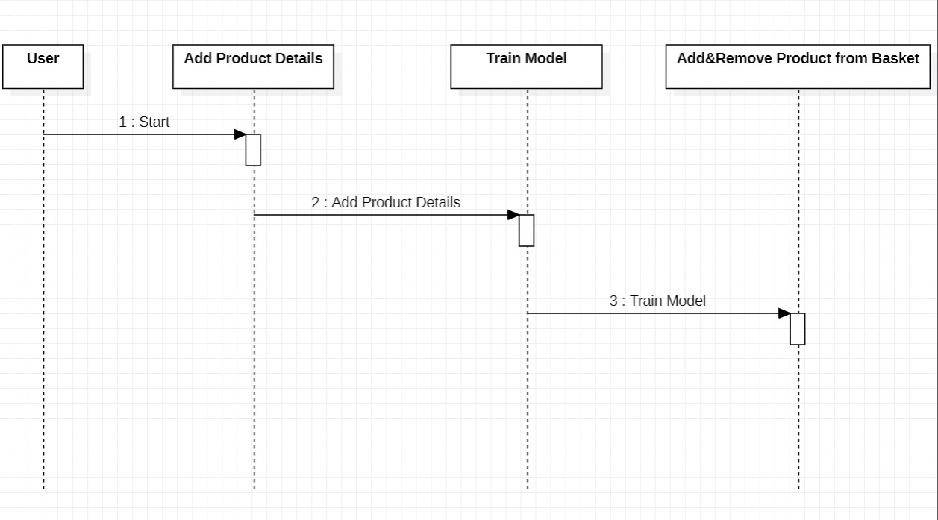
Sequence diagram

Slide 15
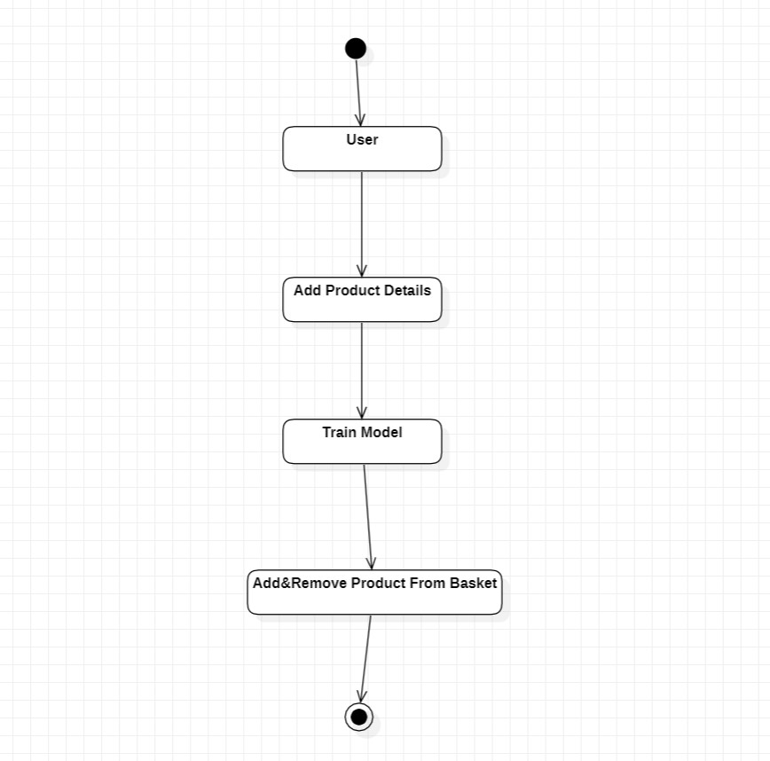
Activity diagram

Slide 16
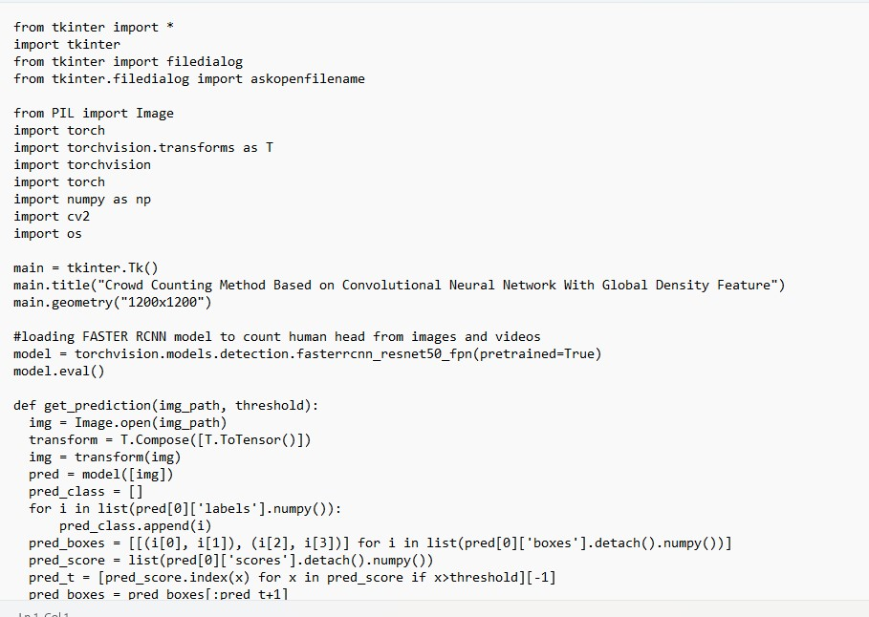
Sample code

Slide 17
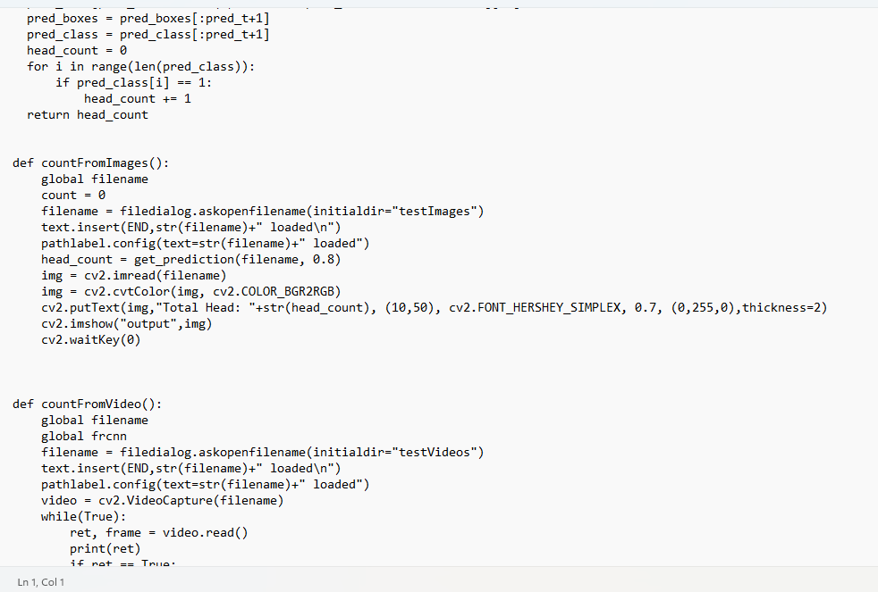

Slide 18
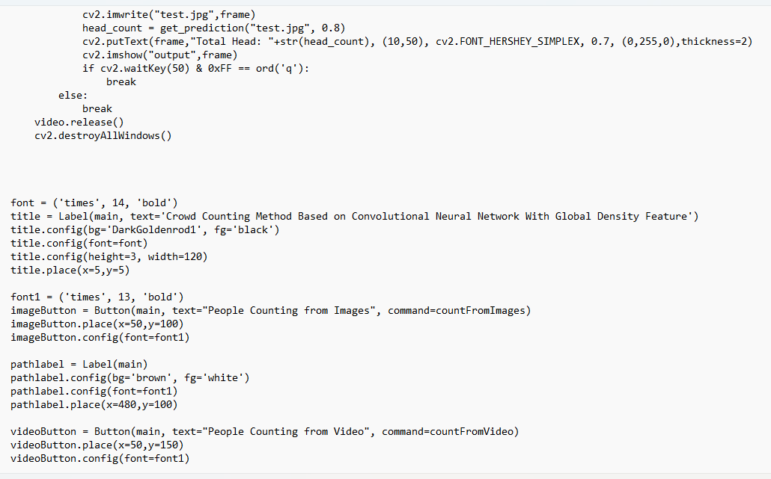

Slide 19
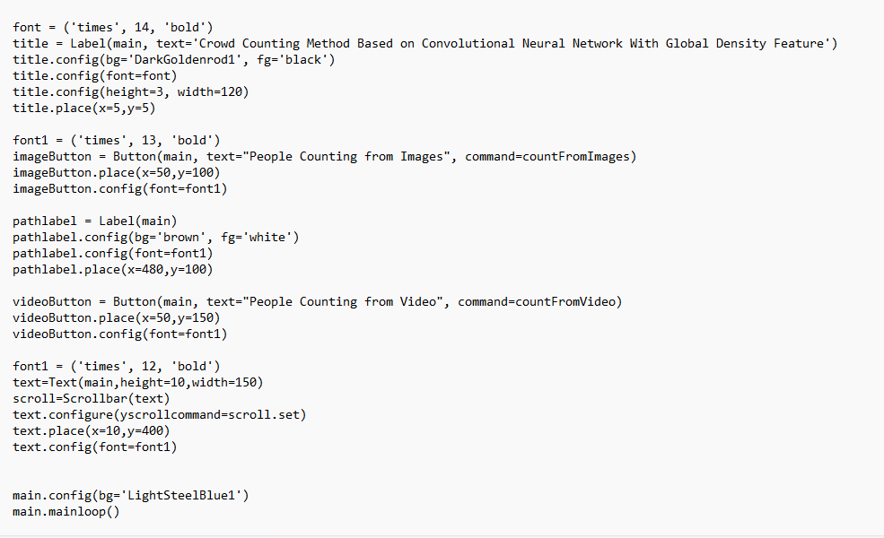

Slide 20
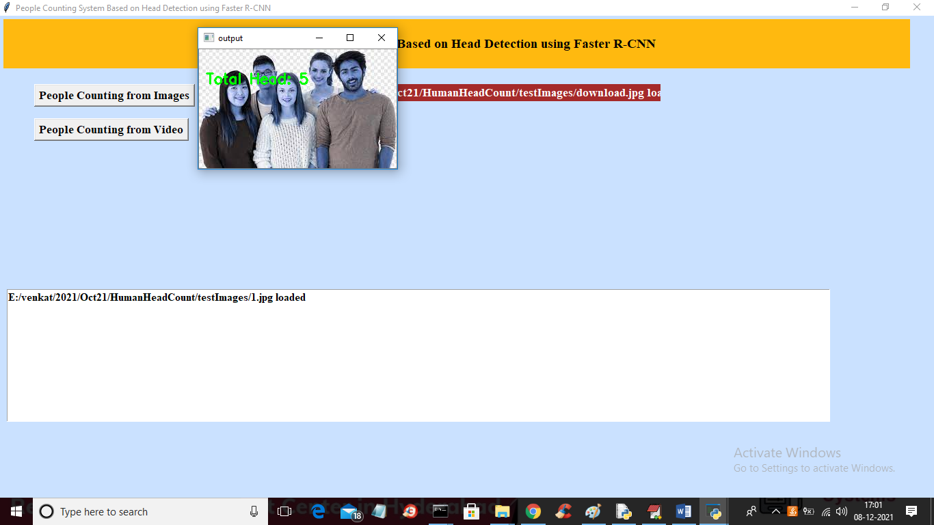
result

Slide 21
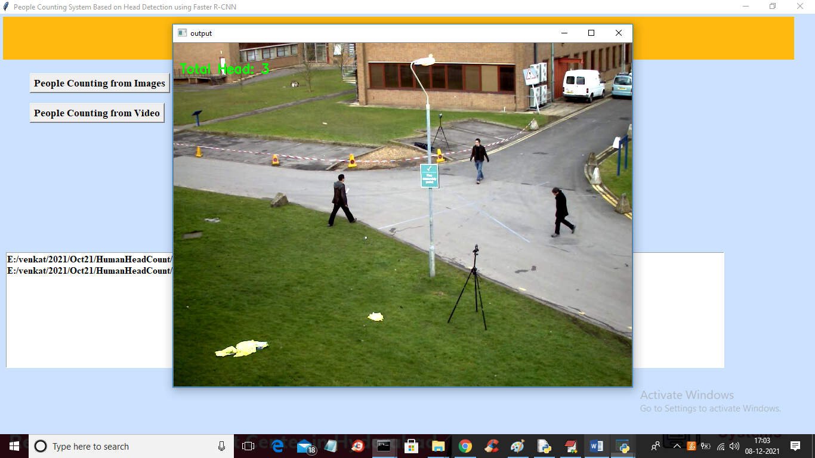

Slide 22
CONCLUSION
In this Project, an improved Convolutional Neural Network combined with global density feature is proposed. It is different from existing crowd counting methods.
The proposed method focuses on uneven crowd distribution. Moreover, the max-ave pooling and deconvolutional layers are used to generate a more comprehensive density map.
The experimental results show that the proposed method achieves competitive performance on different crowd datasets. Due to the high density crowd, some backgrounds will be taken as people by mistakes.
It will bring about noise in the estimated density map and influence the counting results. For the future work,we will focus on reducing the noise in the estimated density map and improving the accuracy of counting

Slide 23
Future scope
Improved Accuracy
Real-time Applications
Dataset Diversity
Human-AI Collaboration
Transfer Learning

Slide 24
references
[1] S. F. Lin, J. Y. Chen, and H. X. Chao, “Estimation of number of people in crowded scenes using perspective transformation,” IEEE Trans. Syst., Man，Cybern. A, Syst., Humans, vol. 31, no.6, pp. 645-654, Nov. 2001.
[2] G. Paweł, K. Kowalak, K. Łukasz, and S. Maćkowiak, “Crowd density estimation based on voxel model in multi-view surveillance systems,” in Proc. IEEE Int. Conf. Syst., Signals, Image Process., Sep. 2015, pp. 216- 219.

Slide 25
Github link
https://github.com/sakethaedula/Crowd-Counting-Method-

Slide 26
THANK YOU

